Slide 1
Fake Job Predictions
Group 8 (GGEZ)
Chu Kang Hao
Timothy
Lim Chong Yao
Isaac

Slide 2



01
02
03
Exploratory
Data Analysis
Cleaning
& Training
Conclusion

Slide 3
Why Explore Fake Jobs?
Fake job postings lead job seekers to being scammed or exploited.
Fake jobs is ever prevalent and scams are on the rise.
According to CNBC, the number of employment scams doubled in 2018 as compared to 2017.
Economic stress and the coronavirus have significantly increased loss of jobs for many
Scams on job postings allow scammers to gain access to personal information, such as bank account details

Slide 4
Why Explore Fake Jobs?
Fake job postings lead job seekers to being scammed or exploited.
Fake jobs is ever prevalent and scams are on the rise.
According to CNBC, the number of employment scams doubled in 2018 as compared to 2017.
Economic stress and the coronavirus have significantly increased loss of jobs for many
Scams on job postings allow scammers to gain access to personal information, such as bank account details

Slide 5
Problems in Dataset

Slide 6
11900
606
Real Jobs
Fake jobs
Problems in Dataset
Incomplete
Job Postings
Textual
Information

Slide 7
11900
606
Let’s
Real Jobs
Fake jobs
Problems in Dataset
Explore
Incomplete
Job Postings
Textual
Information

Slide 8
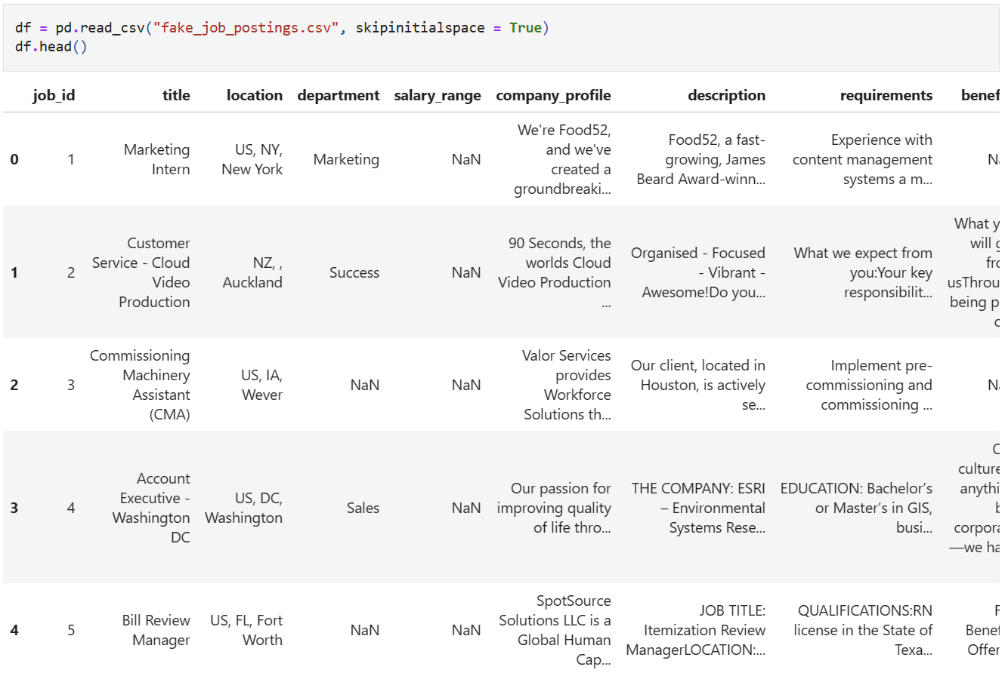
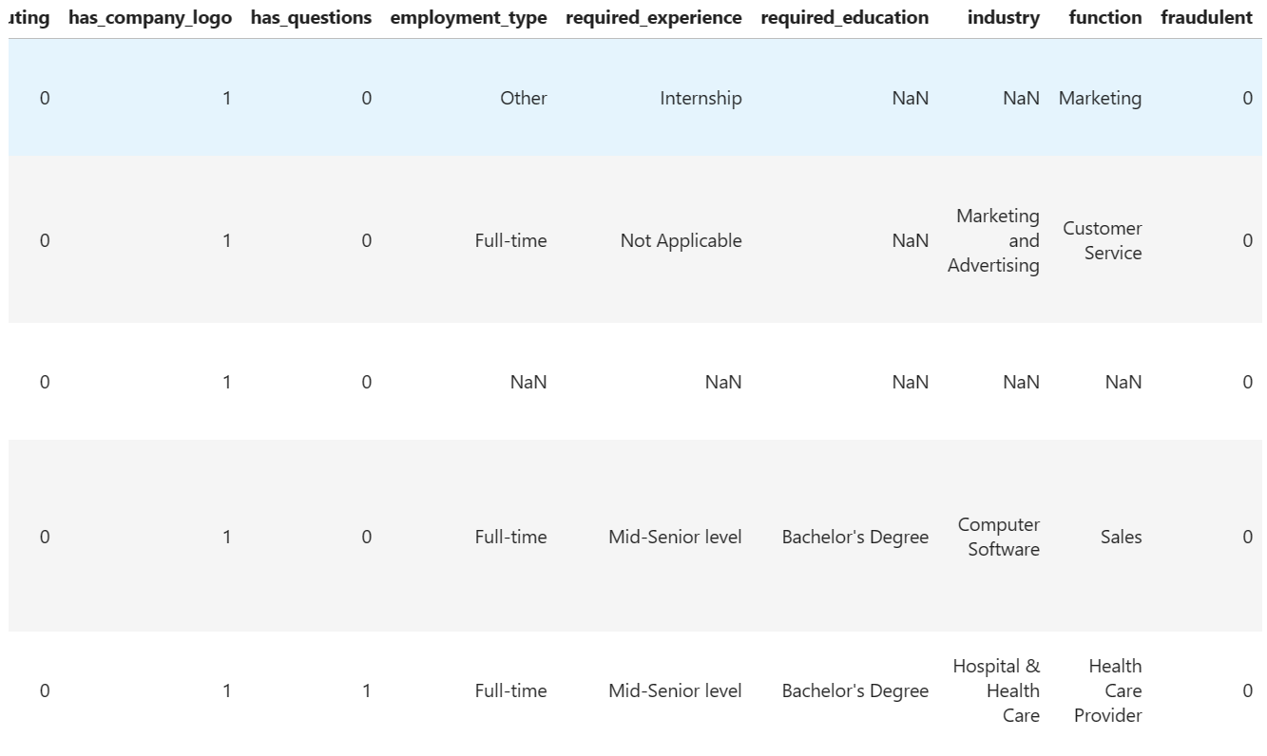
Insights about the Dataset
Problems
1. Formatting inconsistencies
2. Missing values
3. Few meaningful values
4. Heavy on textual data

Slide 9
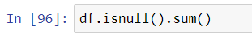
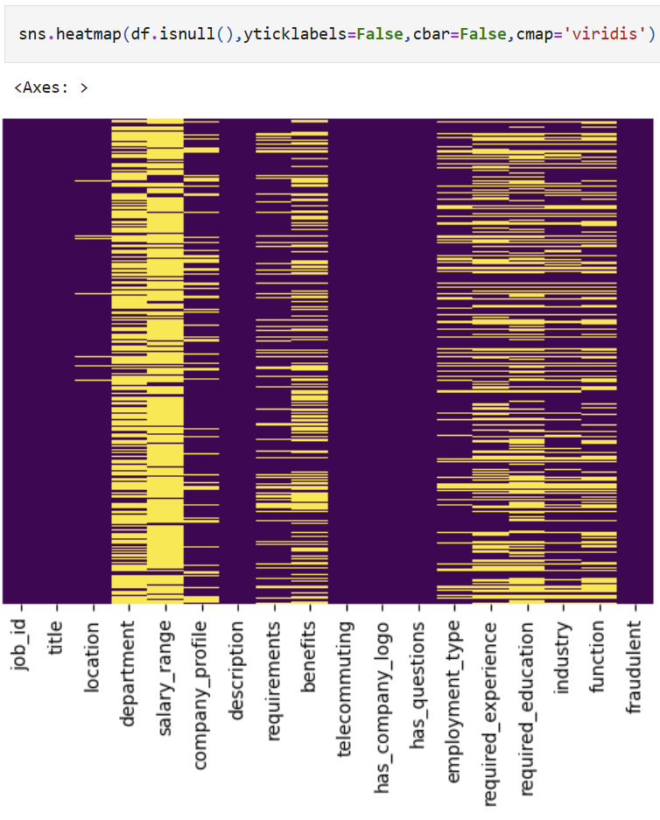
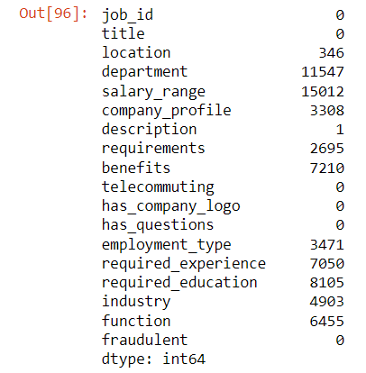
Insights about the Dataset
2. Missing values
As we can see, every column has different amount of missing values.
e.g. job_id is 0 while location is 346.
To handle missing values, we might:
Drop columns containing NaN
Drop unwanted columns
Replace NaN with placeholder values

Slide 10
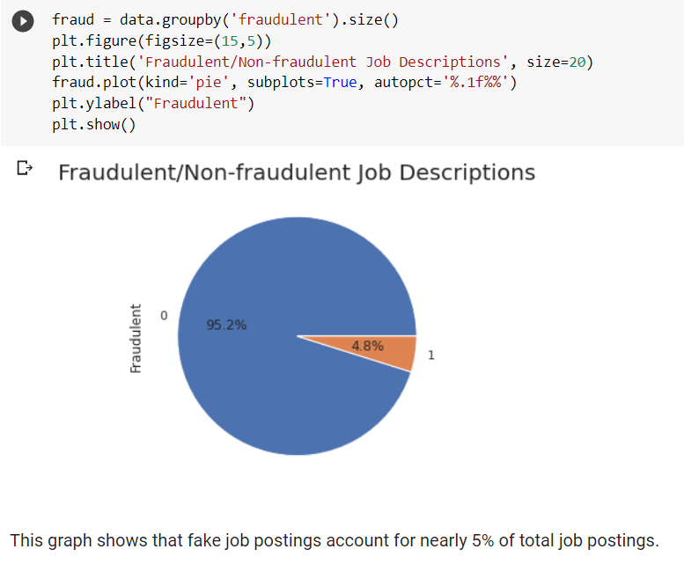
Insights about the Dataset
The data is highly unbalanced
(bias toward non-fraudulent class)!
Need to balance train and test sets when training data

Slide 11
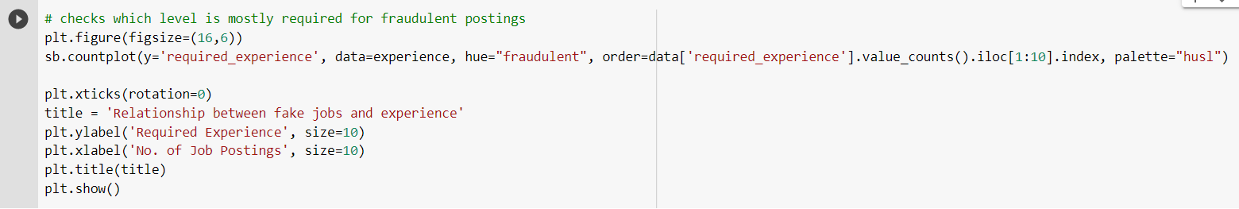
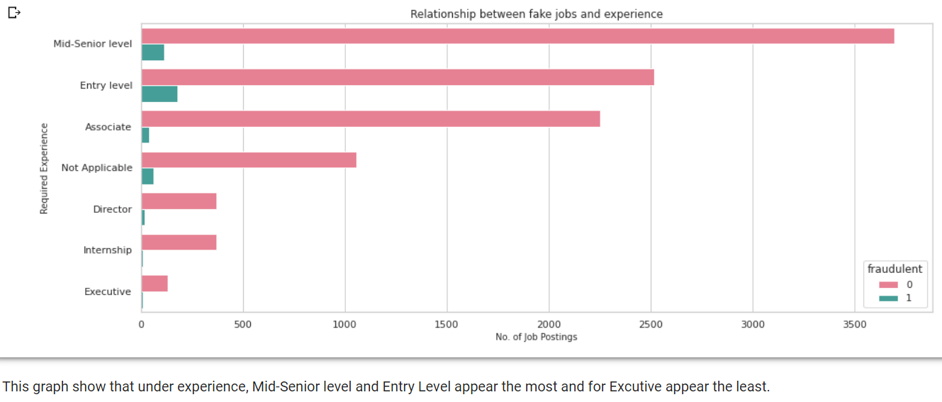
Insights about the Dataset
How does experience relate to fake jobs?
Seem to target Mid-senior level and entry level jobs as they are usually lower-skilled jobs

Slide 12
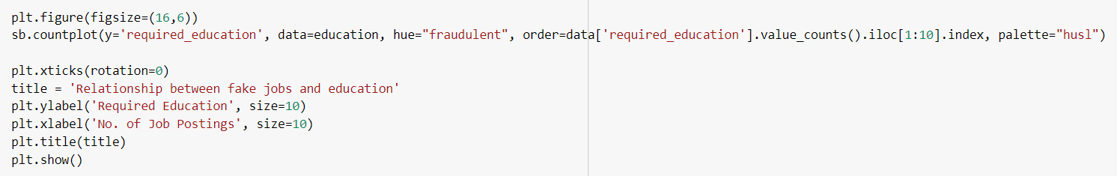
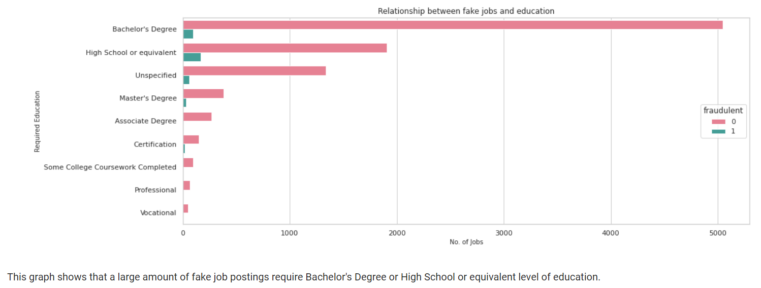
Insights about the Dataset
How does education level
relate to fake jobs?
Bachelor degree holders as they are new to the workforce and are inexperienced job seekers
High school as they are less educated and inexperienced

Slide 13
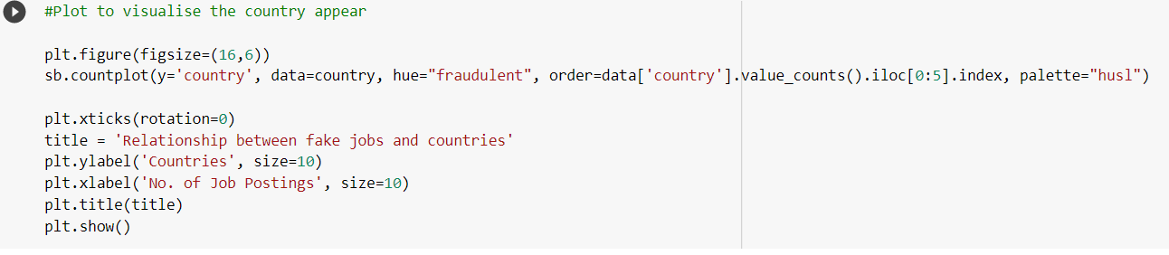
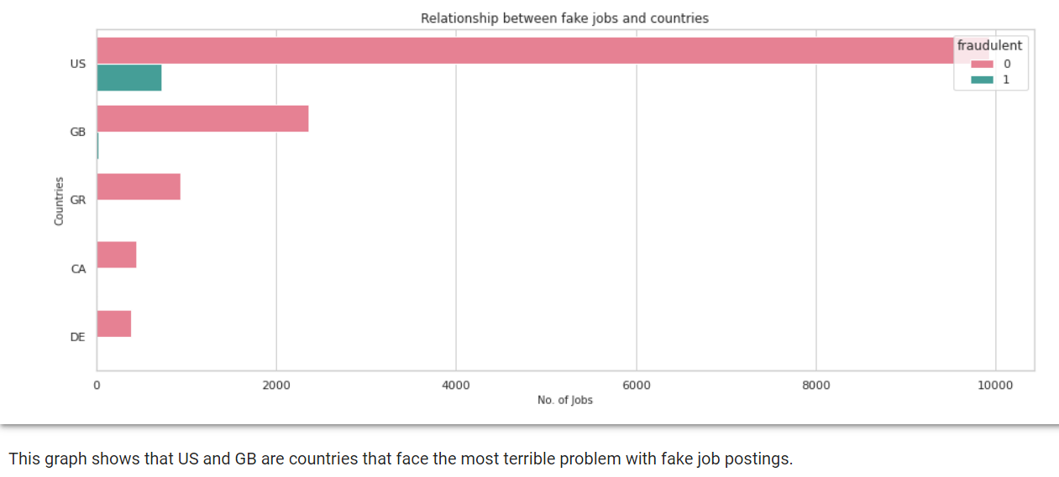
Insights about the Dataset
Which countries have the biggest amount of fake job postings?
US majority
Could segment data to just focus on US to prevent discrepancies of job data across countries?
Not very useful statistic

Slide 14
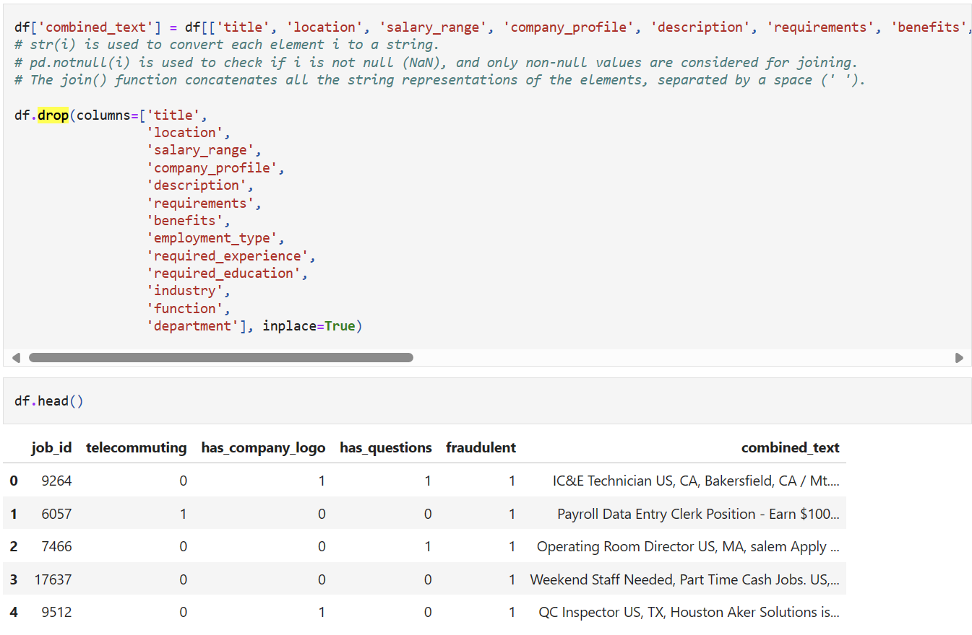
Insights about the Dataset
4. Heavy on textual data
Combine useful text columns into 1 column
Drop text columns that have been combined
Display dataset to check once more

Slide 15
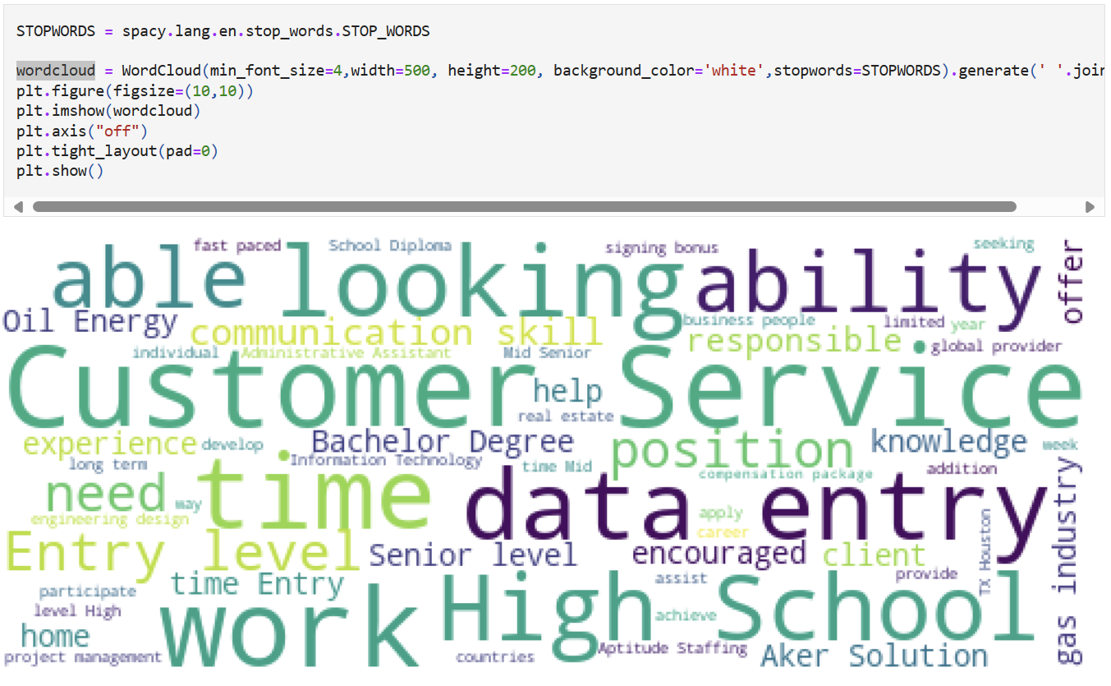
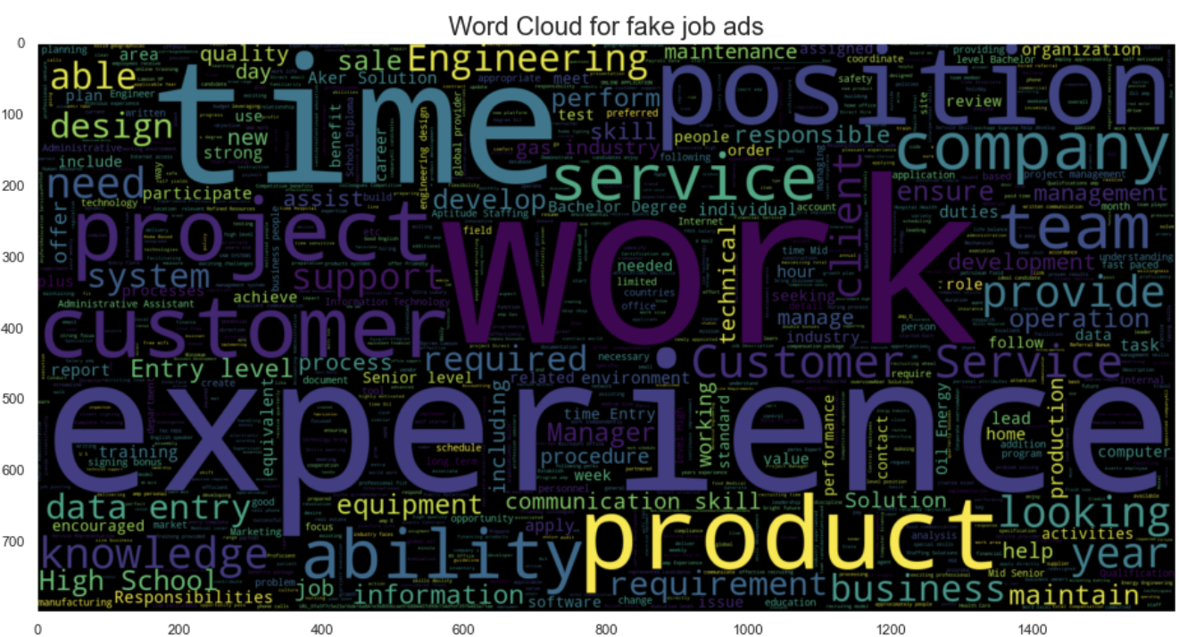

Insights about the Dataset
We used different ways to concatenate texts.
Although wordcloud provides some context about the data,
it is affected heavily by the quality of texts it processes.

Slide 16

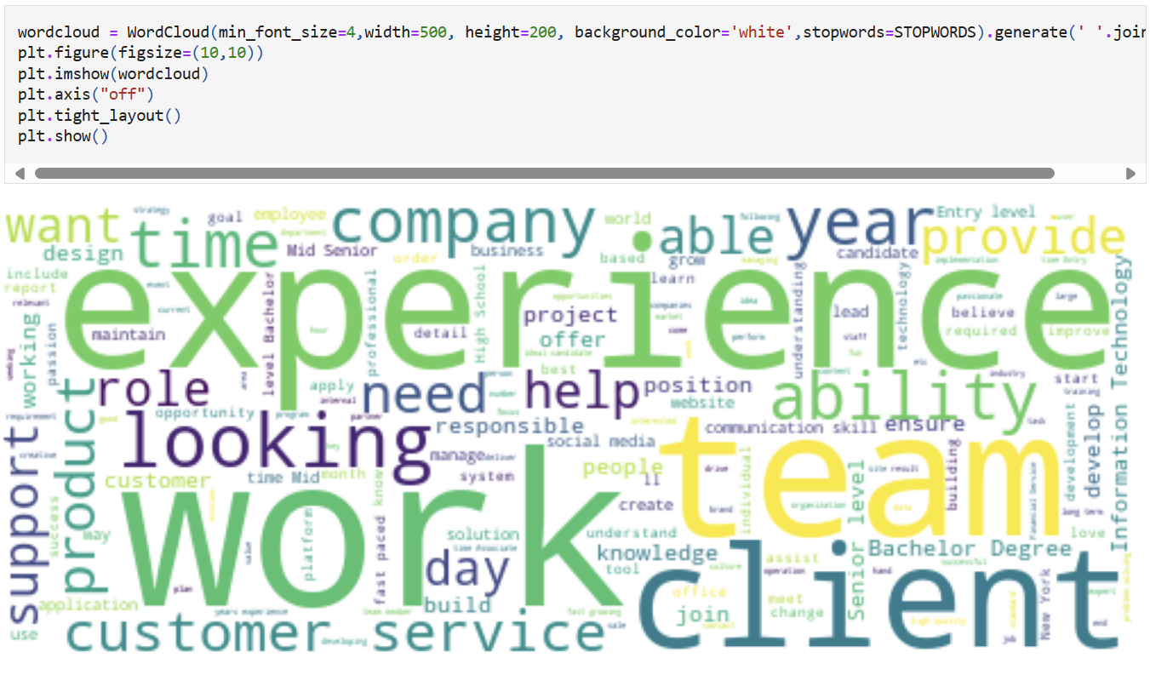

Insights about the Dataset

Slide 17

Data Cleaning

Slide 18
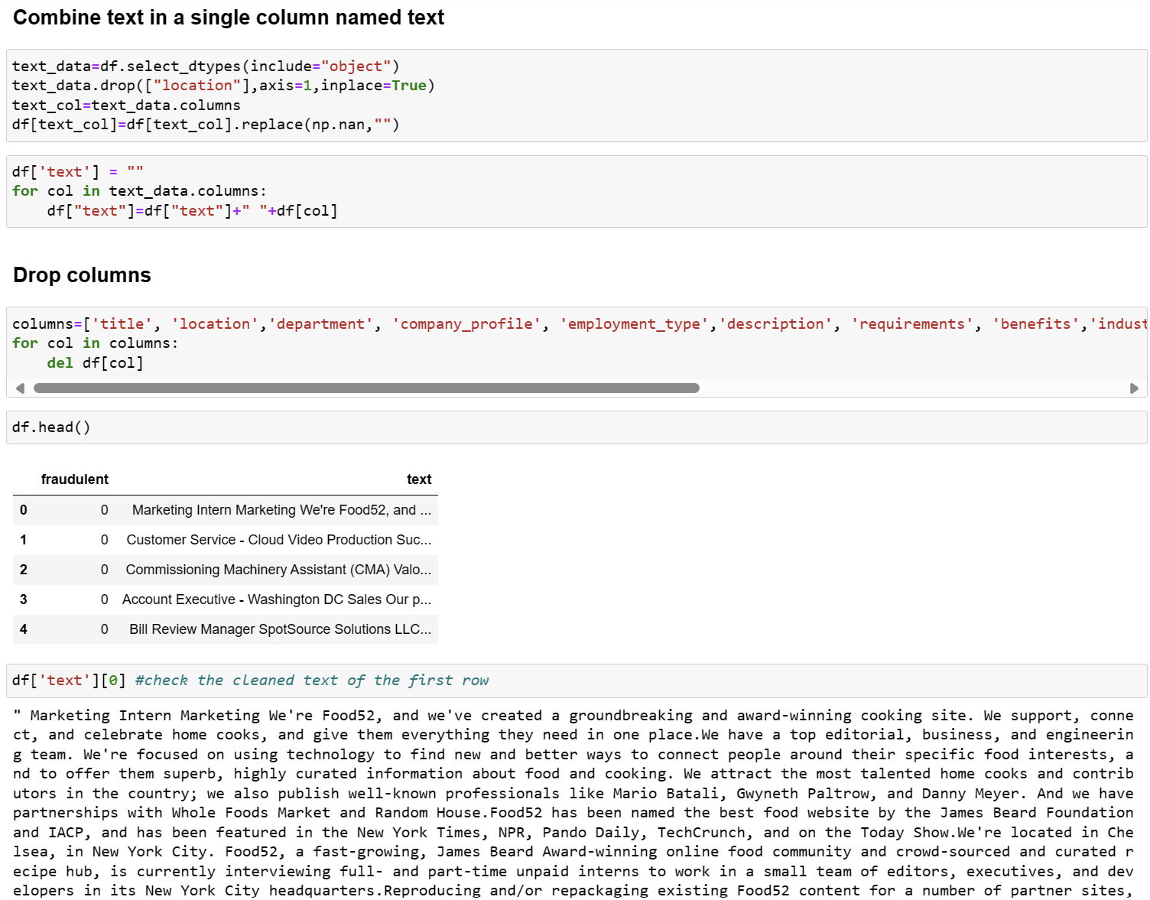
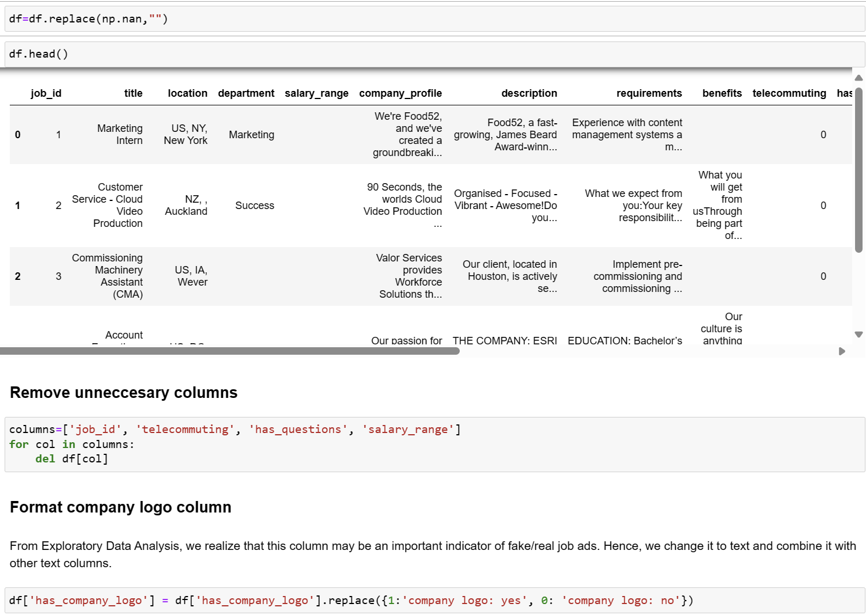

Slide 20

Data pre-processing

Slide 21
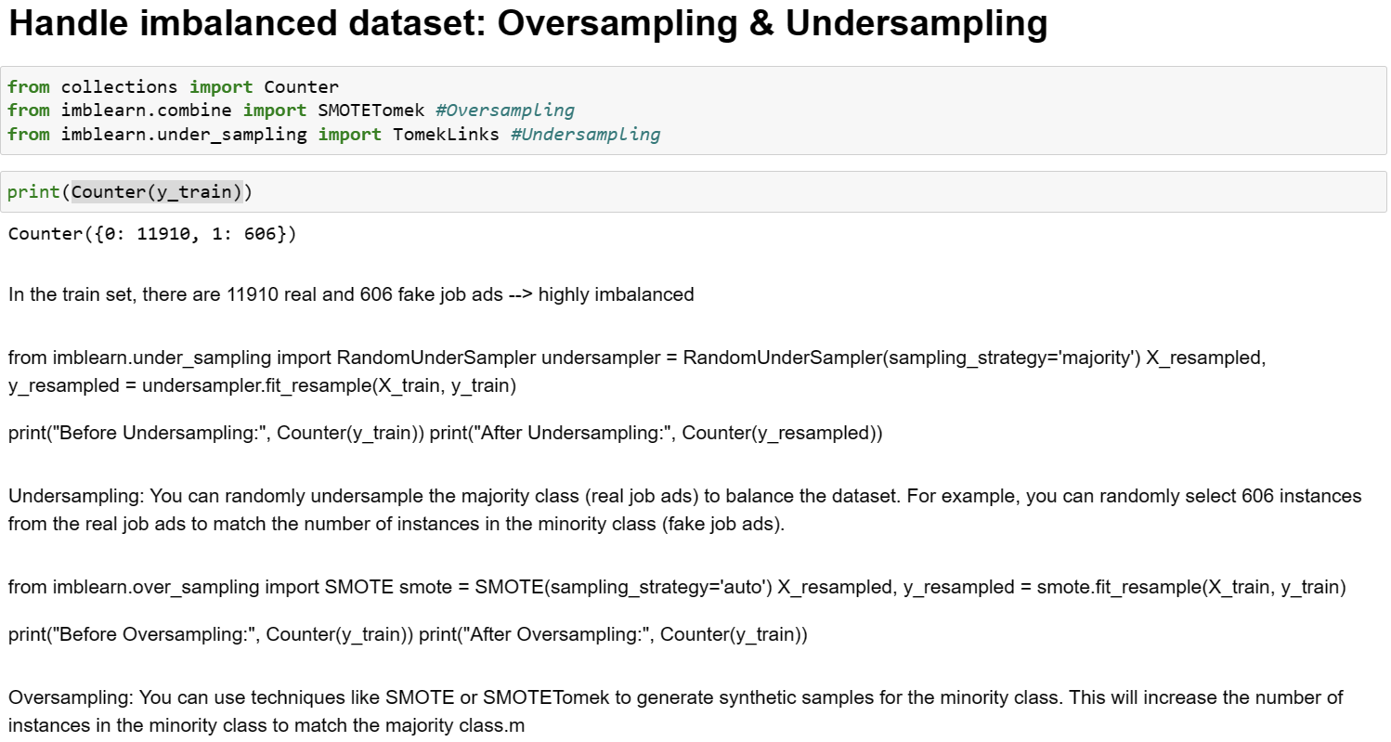
Data pre-processing

Slide 22
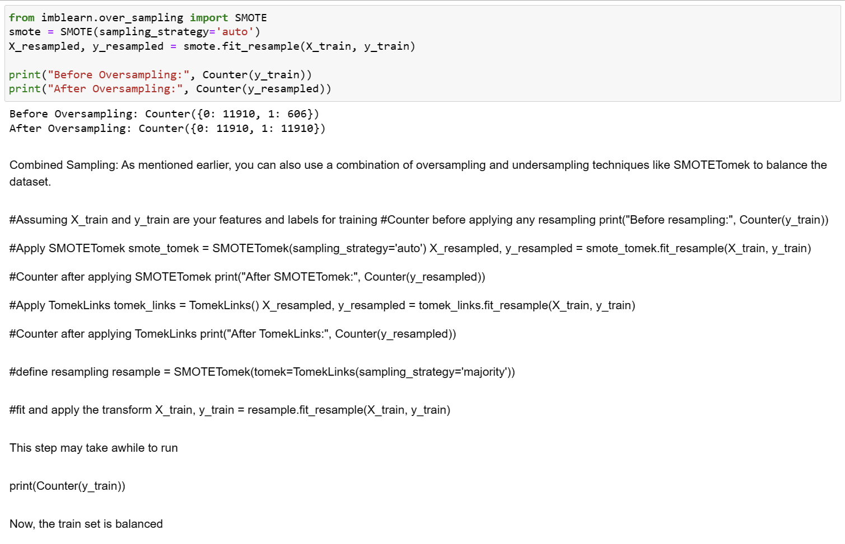
Data pre-processing
We chose oversampling simply because combined sampling took too long.
In ideal circumstances, we could make use of it.

Slide 23
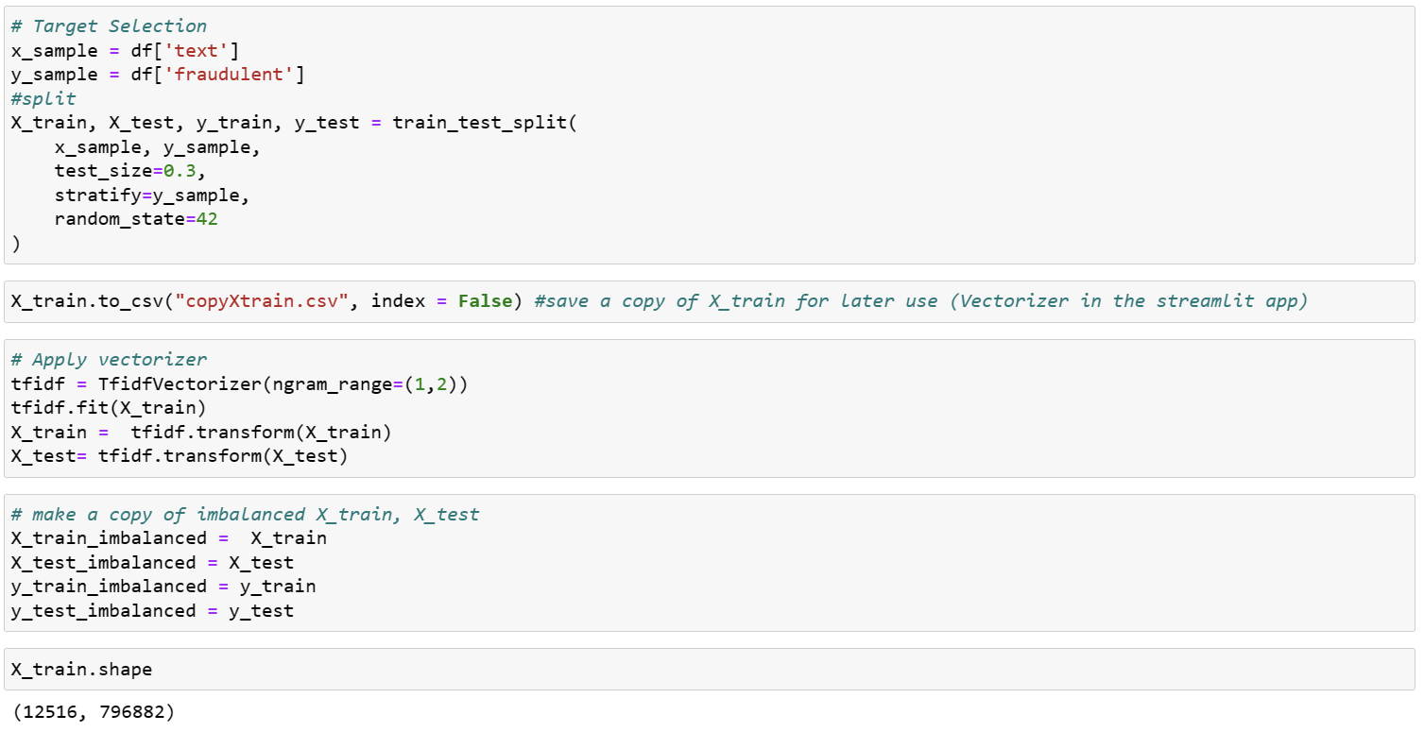
Data pre-processing
We chose oversampling simply because combined sampling took too long.
In ideal circumstances, we could make use of it.
Using one of the techniques in
natural language processing!

Slide 24
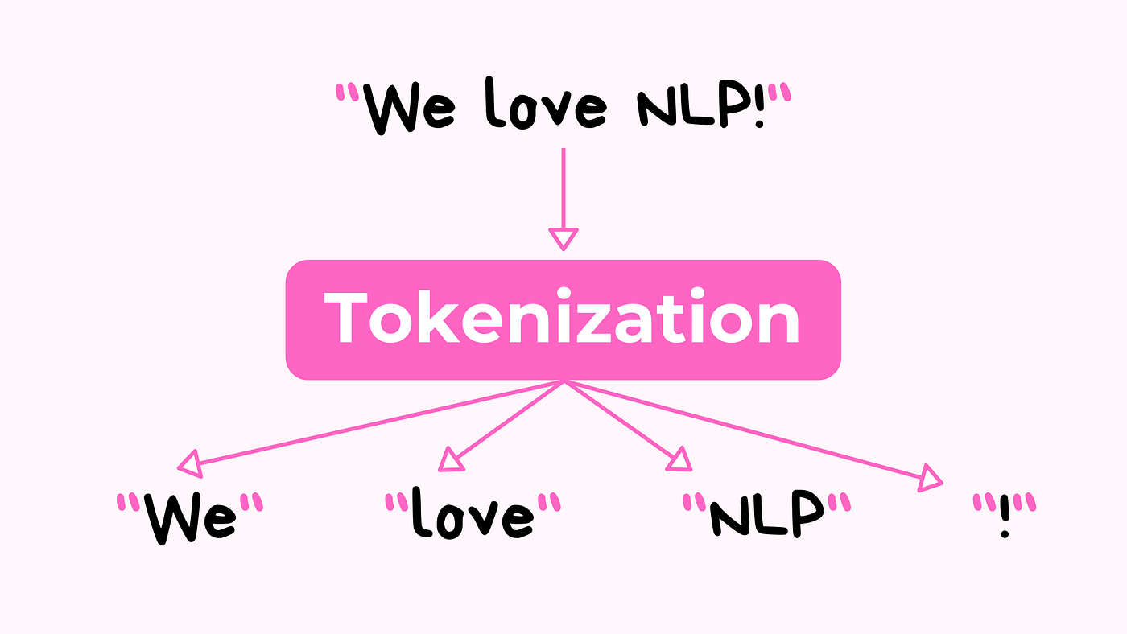
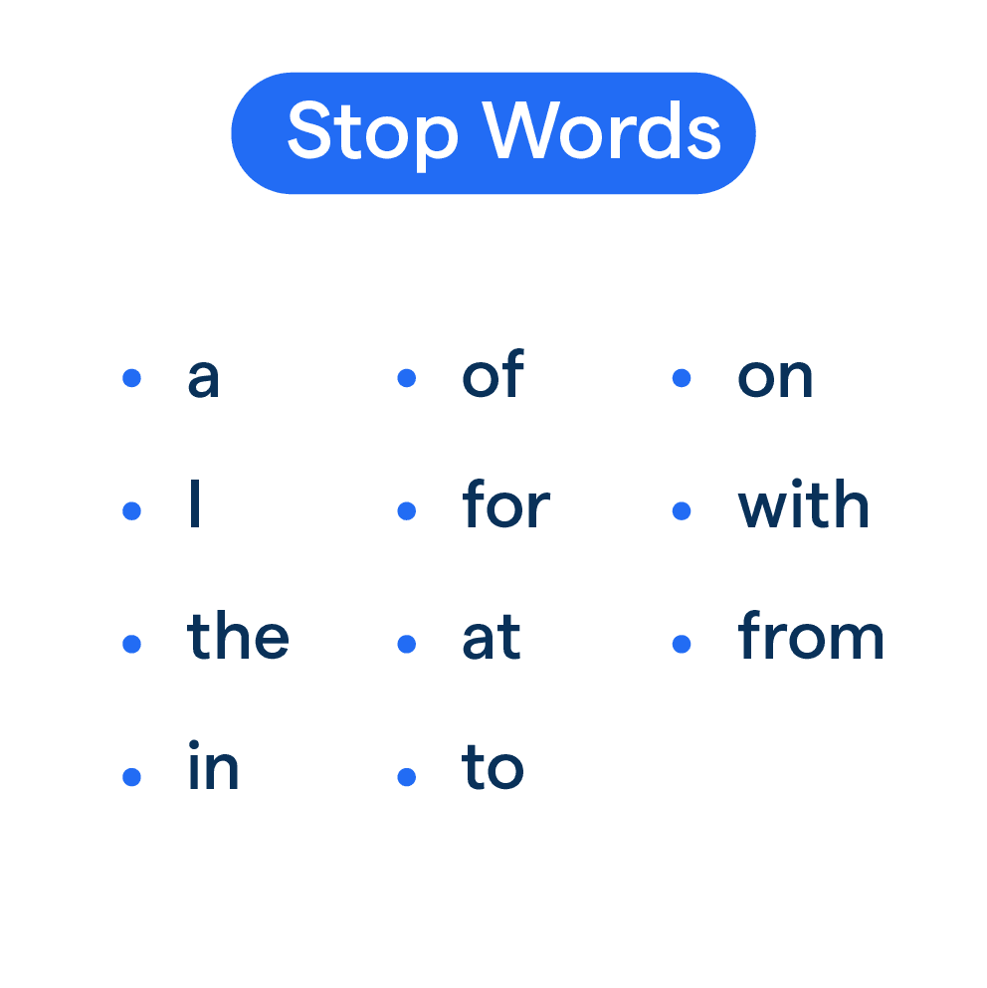
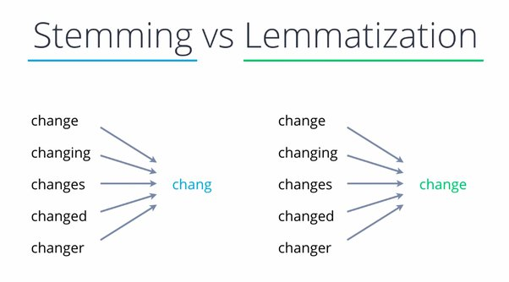
Data pre-processing
Tokenisation
Lowercase
Stopword
Removal
Lemmatization
breaks text into tokens
words that do not add much meaning to sentences.

Slide 25
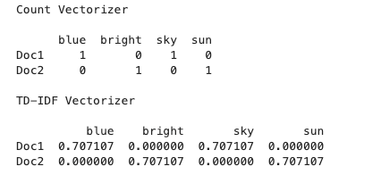
Our choice of NLP technique
TF-IDF - Term Frequency-Inverse Document Frequency.
Technique used in NLP to convert text data into numerical vectors that machine learning algorithms can understand.
Mathematically penalizes words that are abundant by giving them low TF-IDF scores
Higher TF-IDF values = higher importance in the text
Lower TF-IDF values = lower importance in the text

Slide 26


Training

Slide 27
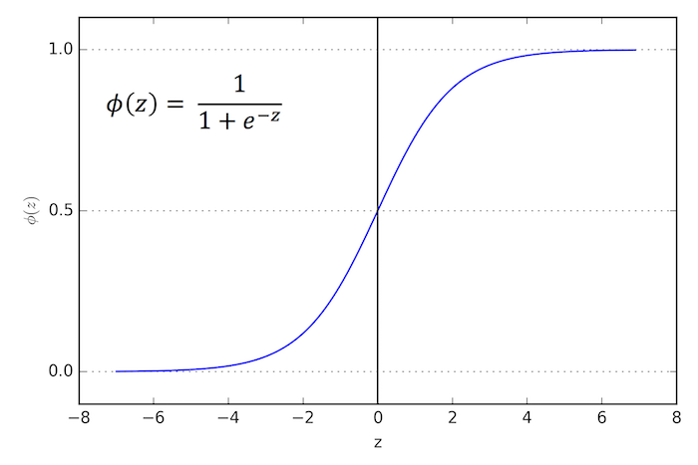

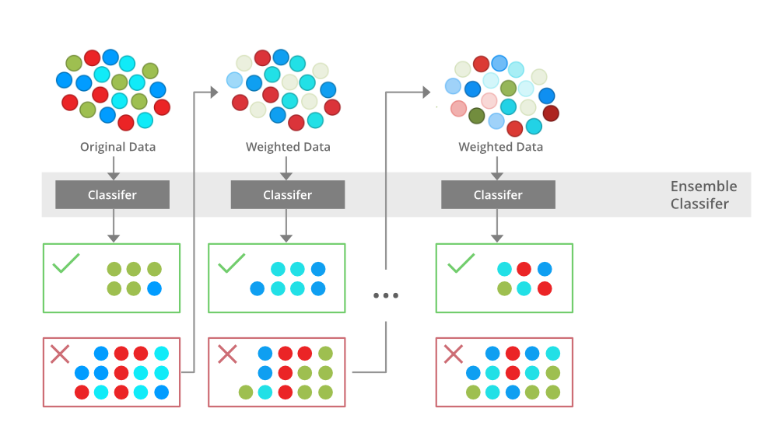
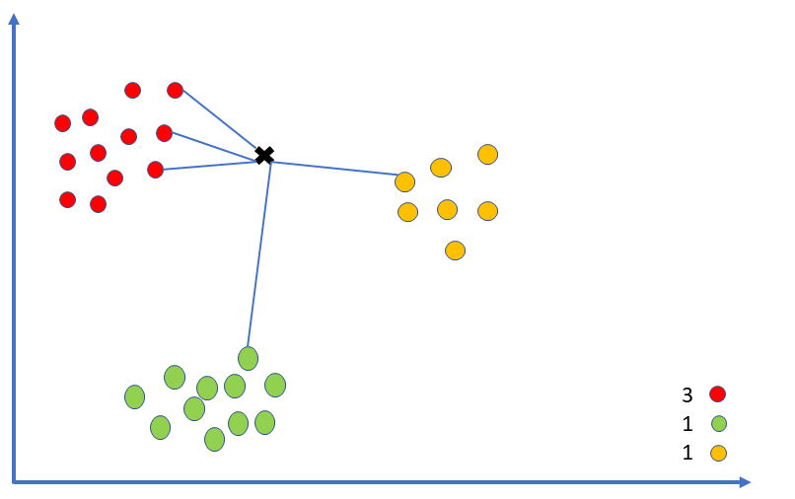
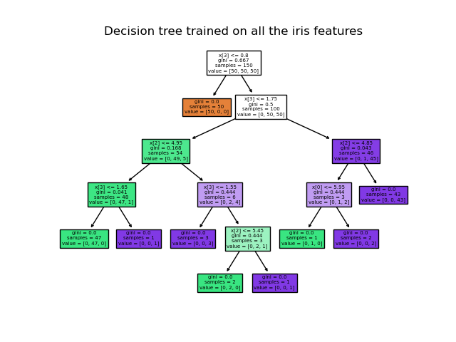
Training the model: Overview
Logistic Regression
Random Forest
XG boost
K Neighbors
Decision Tree

Slide 28
Training the model: Overview
Logistic Regression
Random Forest
K Neighbors
Decision Tree
XG boost

Slide 29
Logistic Regression
Logistic Regression assumes a linear decision boundary, which might be effective if the relationship between features and the target variable (fake vs. real job) is approximately linear.
Random Forest
K Neighbors
Decision Tree
XG boost
Simple, interpretable, and computationally efficient.

Slide 30
Random Forest
Combines multiple decision trees to make predictions, which helps in capturing complex patterns and interactions between features.
Less prone to overfitting compared to individual decision trees, making it suitable for handling noisy or high-dimensional data.
Logistic Regression
K Neighbors
Decision Tree
XG boost

Slide 31
K Neighbors
Capture complex decision boundaries and patterns in the data without making strong assumptions about the underlying distribution.
KNN considers local patterns in the feature space, which might be useful for identifying clusters or regions in the data where fake job postings are prevalent.
Random Forest
Decision Tree
XG boost
Logistic Regression

Slide 32
Decision Tree
Can capture non-linear relationships and interactions between features, which might be beneficial if the relationship between features and fake job postings is non-linear.
Decision Trees provide interpretable results in the form of hierarchical tree-like structures, making it easy to understand the decision-making process.
K Neighbors
XG boost
Random Forest
Logistic Regression

Slide 33
Combines multiple weak learners (usually decision trees) sequentially. It optimizes an objective function to minimize errors, making it effective in capturing complex patterns and improving prediction accuracy.
XG boost
Highly scalable and efficient, making it suitable for processing large volumes of job postings and handling high-dimensional data efficiently.
K Neighbors
Decision Tree
Logistic Regression
Random Forest

Slide 34
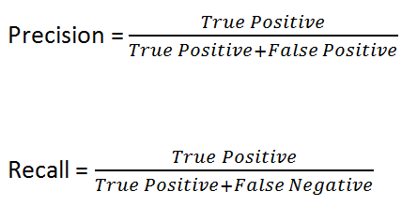
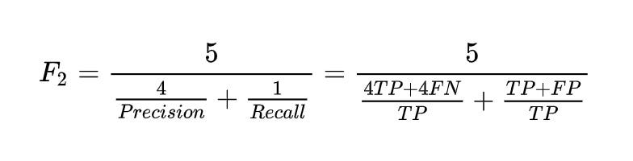
Training the model: Overview
We divide the data into train set and test set with the ratio 70:30.
We train each model and apply them to the test set to find out:
Accuracy
Precision
Recall F2-score (F2 score gives more importance to correctly classifying positive instances (minimizing false negatives), which can be critical in certain applications like medical diagnosis or fraud detection.)
Confusion matrix
ROC AUC score (Higher ROC AUC scores indicate better overall performance of the model in distinguishing between positive and negative instances.)

Slide 35
Training the model: Overview
Prioritizing recall with the F2 score is crucial in identifying fake job postings.
False negatives (missed fake job postings) can harm job seekers by wasting time and leading to financial loss or identity theft.
Placing more weight on recall ensures the model focuses on correctly identifying fake job postings, safeguarding job seekers from fraudulent activities.
While false positives may cause inconvenience, minimizing the risk to job seekers is paramount, making the F2 score an effective metric for maintaining trust in online job platforms.
Notes:
Identifying Fake Jobs:
In the context of job postings, false negatives (incorrectly identifying a legitimate job as fake) can waste job seekers' time and potentially deter them from applying for genuine employment opportunities. It can also lead to missed career advancement or financial stability.
Prioritizing recall ensures that the model minimizes the number of false negatives, meaning it correctly identifies as many fake job postings as possible to protect job seekers from scams and fraudulent activities.
While false positives (legitimate job postings incorrectly flagged as fake) may cause some inconvenience for employers or job platforms by requiring additional verification steps, the primary concern is to minimize the risk of job seekers falling victim to fraudulent job postings.
For example, in online job portals or recruitment platforms, false negatives could mean failing to detect fake job postings that promise unrealistic salaries, require upfront payment, or involve other deceptive practices, potentially leading to financial loss or identity theft for job seekers.
In this scenario, prioritizing recall with the F2 score ensures that the model focuses on correctly identifying fake job postings, which is crucial for safeguarding job seekers from fraudulent activities and maintaining trust in online job platforms.

Slide 36
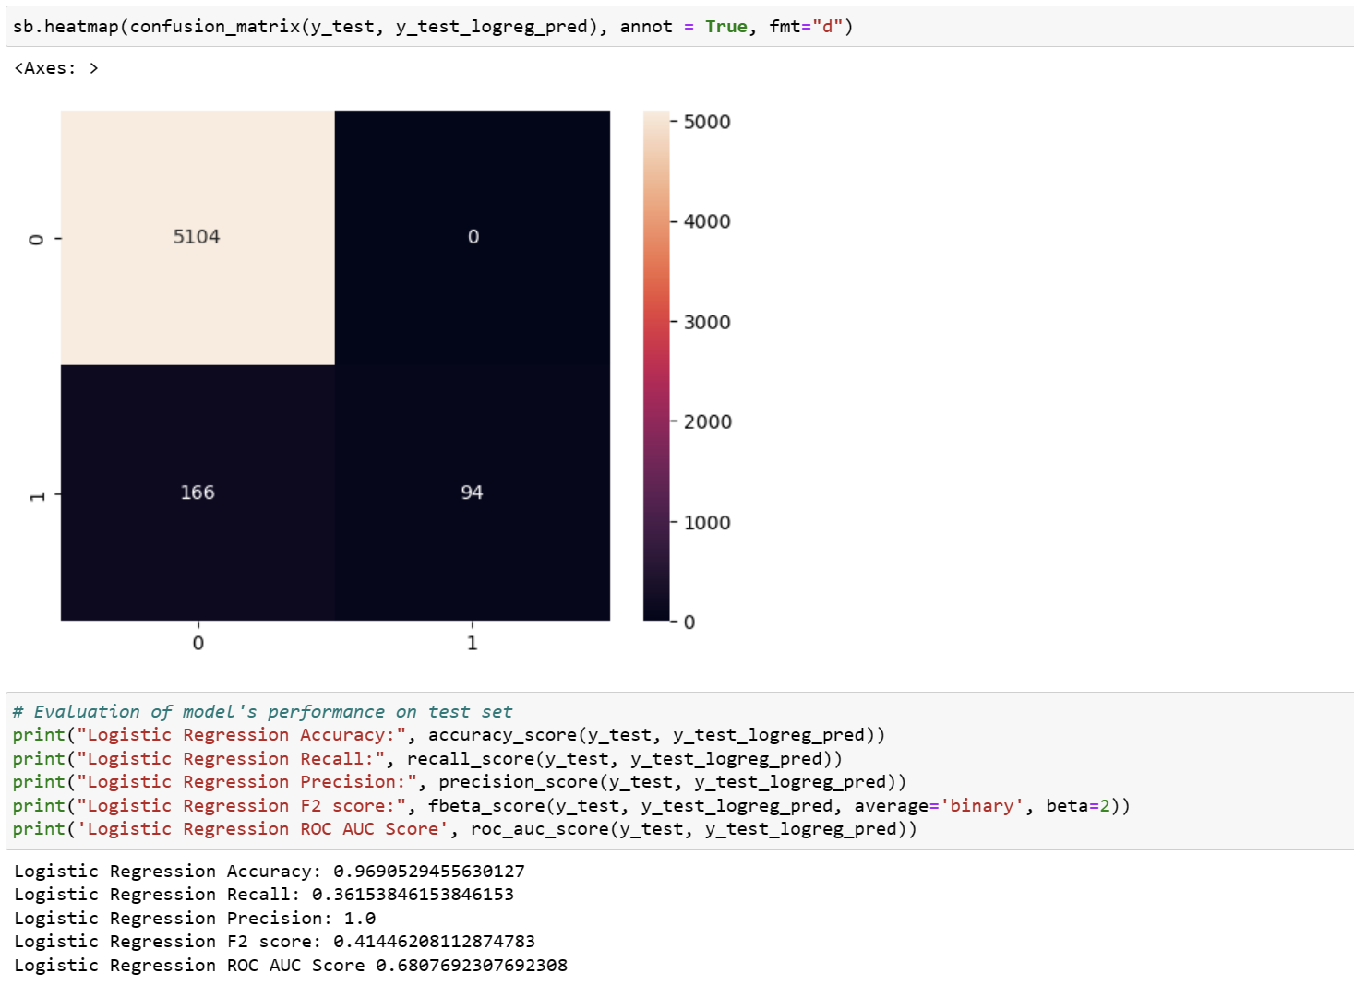
Logistic Regression
Correctly predicted that the job postings were Real.
Predicted Fake when they were Real.
Correctly predicted that the job postings were Fake.
Predicted Real when they were actually Fake.

Slide 37
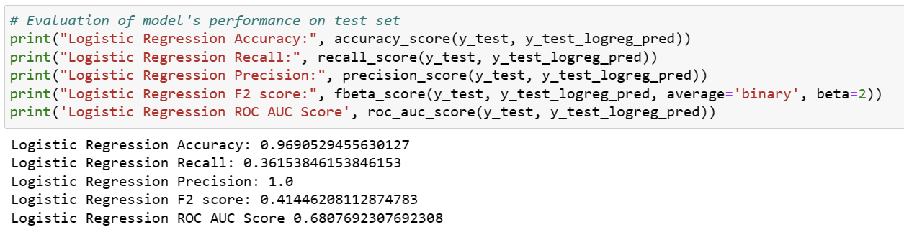
- **Accuracy:** 0.96
- overall correctness of the model's predictions is High.
- **Recall:** 0.36
Model misses a significant portion of actual fake job postings.
- **Precision:** 1.0
- When the model predicts a job posting as fake, it is almost always correct.
- **F2 Score:** 0.41
- Need to prioritise recall more
- **ROC AUC Score:** 0.68
- Above 0.5, indicating better-than-random performance, but there is still room for improvement.

Slide 38
True positive = Actually fake job
 | Logistic Regression | Random Forest | K-Neighbors | Decision Tree | XGBoost
Accuracy correctness | 0.9691 | 0.9843 | 0.9843 | 0.9808 | 0.9864
Recall ability of the model to avoid missing positive cases | 0.3615 | 0.6808 | 0.7615 | 0.8231 | 0.7615
Precision avoid incorrectly labeling -ve instances as +ve | 1.0 | 0.9944 | 0.9 | 0.7897 | 0.9474
F2 Score | 0.4145 | 0.7266 | 0.7857 | 0.8162 | 0.7926
ROC AUC >0.5, better-than-random performance | 0.6807 | 0.8403 | 0.8786 | 0.9060 | 0.8797
Relatively high recall, captures a good proportion of actual positive instances (fake job postings).
Notes:
In summary, all four models perform well overall, with high accuracy and relatively high recall. However, each model has its strengths and weaknesses. Decision Tree has the highest recall, while XGBoost Classifier achieves the highest accuracy and precision. Depending on the specific requirements and priorities of the task, any of these models could be a suitable choice.

Slide 39


a different NLP technique?

Slide 40
spaCy

Slide 41
spaCy is a powerful NLP library that provides various functionalities.
It's designed for advanced text processing tasks and offers state-of-the-art performance.
While spaCy can be slower than simpler techniques like TF-IDF Vectorizer for basic tokenization tasks, it shines in more complex tasks where it offers optimized implementations and parallel processing capabilities.
spaCy

Slide 42
Part-of-speech (POS) Tagging: This involves labeling each word with its grammatical category.
Dependency Parsing: spaCy can analyze the syntactic structure of sentences. (identifying the relationships between words in a sentence and representing them as a dependency tree. Each word is assigned a grammatical role (e.g., subject, object) and linked to its head word.)
Named Entity Recognition (NER): NER is the task of identifying and classifying named entities in text, such as persons, organizations, locations, dates, and more.

Slide 43
 | LR (Tf-idf) | LR (spaCy) | Decision Tree (Tf-idf) | Decision Tree (spaCy)
Accuracy correctness | 0.9691 | 0.9971 | 0.9808 | 0.9937
Recall ability of the model to avoid missing positive cases | 0.3615 | 1.0 | 0.8231 | 1.0
Precision avoid incorrectly labeling -ve instances as +ve | 1.0 | 0.9937 | 0.7897 | 0.7897
Spacy's Strength in Recall: Spacy-based techniques seem to be highly effective in identifying fake job postings. This indicates that Spacy captures relevant patterns in the text data that are crucial for recognizing fake jobs.
TF-IDF's Performance: While TF-IDF achieves slightly lower recall compared to Spacy, it still performs reasonably well. This suggests that TF-IDF is effective in capturing important textual features, albeit not as comprehensively as Spacy.
Similar Accuracy and Precision: This indicates that while Spacy may excel in recall, TF-IDF can still contribute to overall model performance.

Slide 44


Slide 45




Contribution of work
Exploratory Data Analysis: Lim Chong Yao, Chu Kang Hao, Timothy & Isaac
Data Cleaning: Lim Chong Yao & Chu Kang Hao
Data preprocessing (TF-IDF + spaCy): Lim Chong Yao
Slides: Lim Chong Yao & Chu Kang Hao

Slide 46
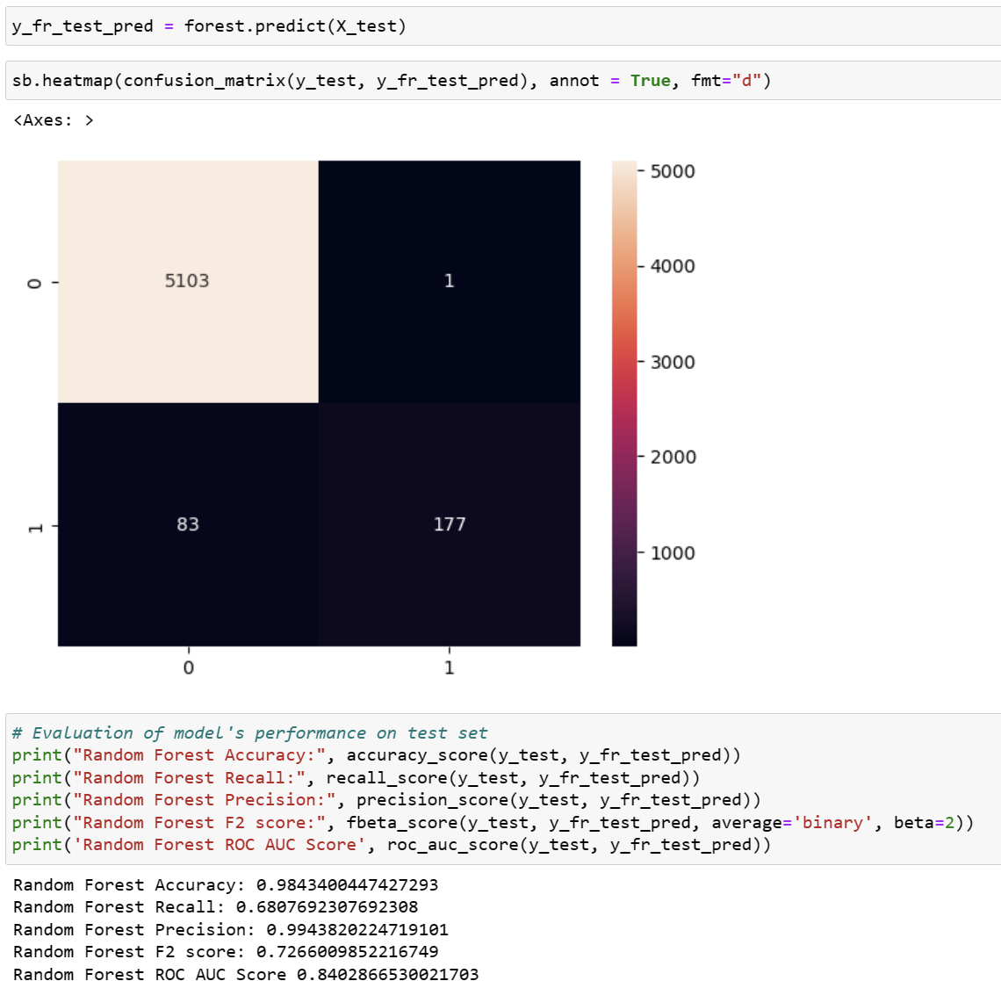
Random Forest
Correctly predicted that the job postings were Real.
Predicted Fake when they were Real.
Correctly predicted that the job postings were Fake.
Predicted Real when they were actually Fake.

Slide 47
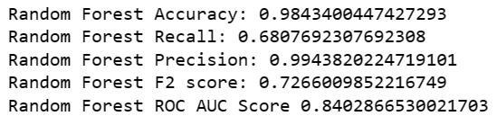
- **Accuracy:** 0.98
- overall correctness of the model's predictions is High.
- **Recall:** 0.68
- Relatively high recall, captures a good proportion of actual positive instances (fake job postings).
- **Precision:** 0.99
- When the model predicts a job posting as fake, it is almost always correct.
- **F2 Score:** 0.73
- Balances recall and precision, giving more weight to recall.
- Effectively prioritizes the correct identification of fake job postings while maintaining a high precision.
- **ROC AUC Score:** 0.84
- Much better than Logistic Regression (0.68)

Slide 48
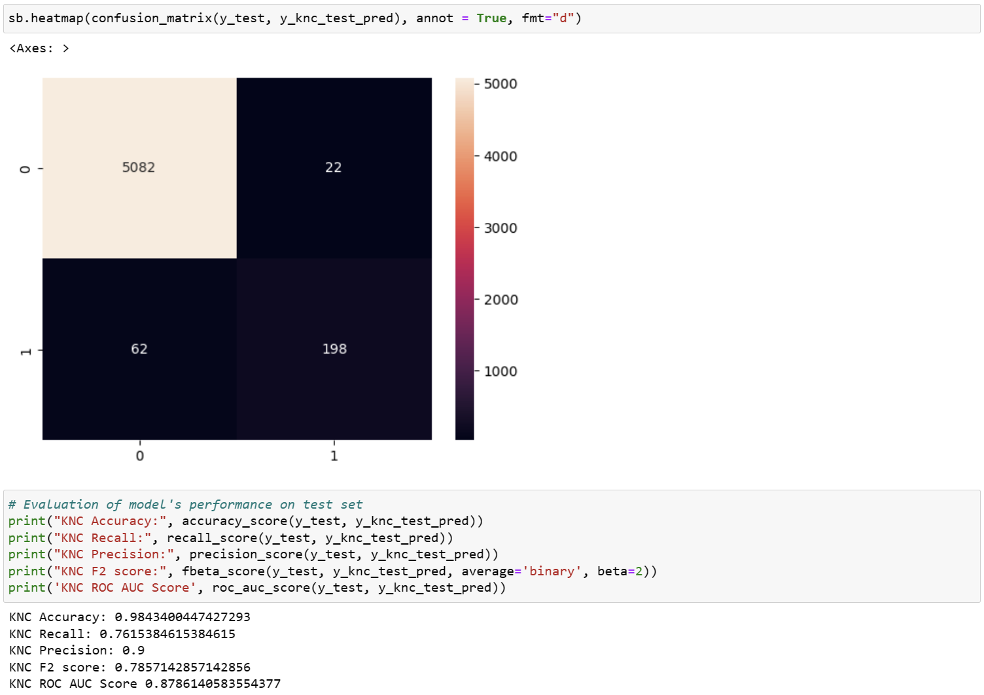
K-neighbours
Correctly predicted that the job postings were Real.
Predicted Fake when they were Real.
Correctly predicted that the job postings were Fake.
Predicted Real when they were actually Fake.

Slide 49
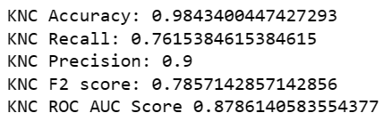
- **Accuracy:** 0.98
- overall correctness of the model's predictions is High.
- **Recall:** 0.76
Model misses a significant portion of actual fake job postings.
- **Precision:** 0.9
- When the model predicts a job posting as fake, it is almost always correct.
- **F2 Score:** 0.79
- Need to prioritise recall more
- **ROC AUC Score:** 0.88
- Above 0.5, indicating better-than-random performance, but there is still room for improvement.

Slide 50
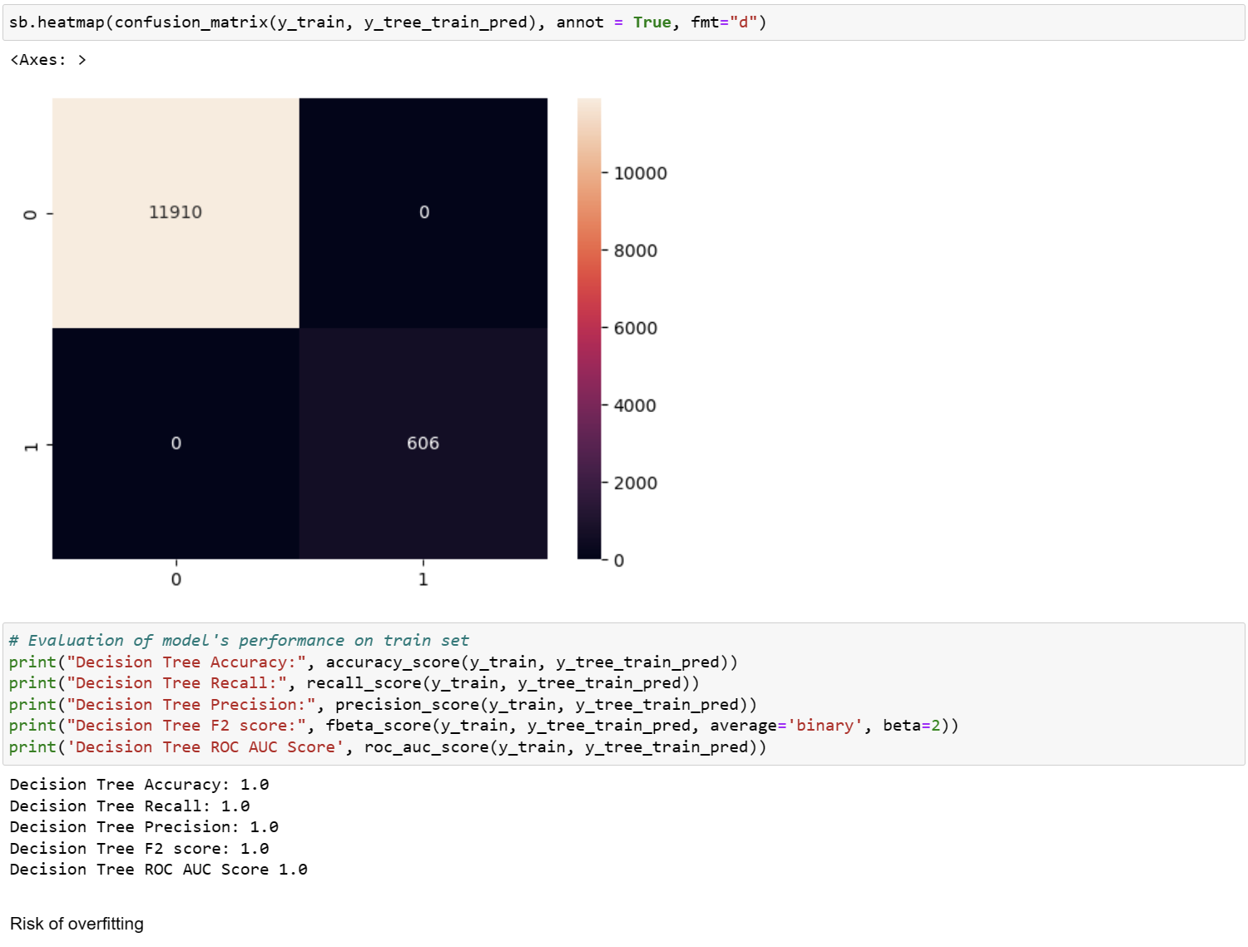
Decision Tree
Correctly predicted that the job postings were Real.
Predicted Fake when they were Real.
Correctly predicted that the job postings were Fake.
Predicted Real when they were actually Fake.

Slide 51
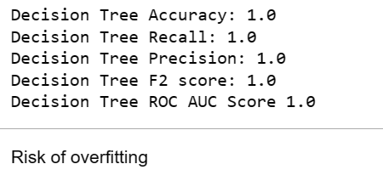
- **Accuracy:** 0.96
- overall correctness of the model's predictions is High.
- **Recall:** 0.36
Model misses a significant portion of actual fake job postings.
- **Precision:** 1.0
- When the model predicts a job posting as fake, it is almost always correct.
- **F2 Score:** 0.41
- Need to prioritise recall more
- **ROC AUC Score:** 0.68
- Above 0.5, indicating better-than-random performance, but there is still room for improvement.

Slide 52
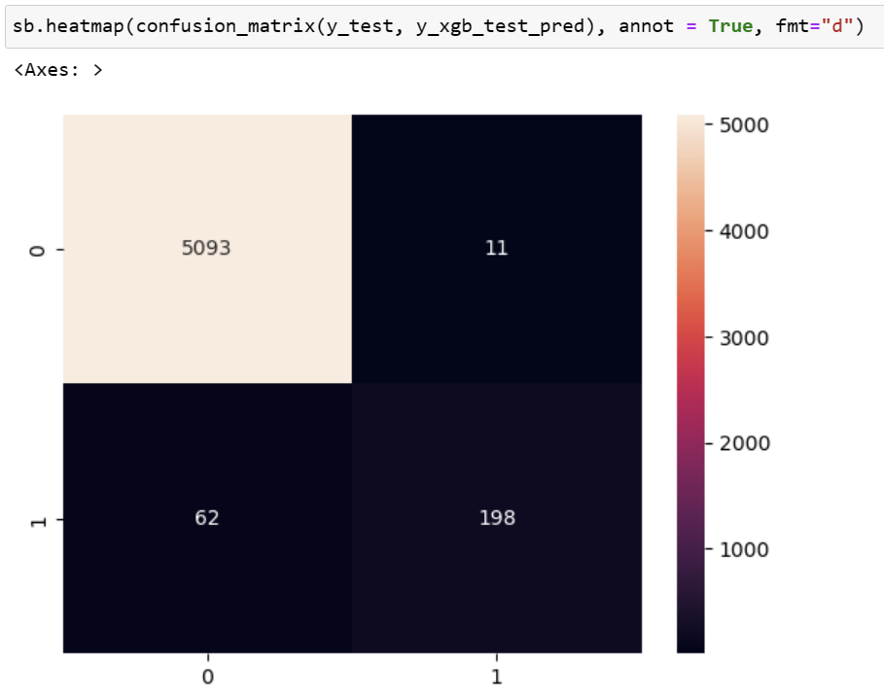
XGBoost Classifier
Correctly predicted that the job postings were Real.
Predicted Fake when they were Real.
Correctly predicted that the job postings were Fake.
Predicted Real when they were actually Fake.

Slide 53
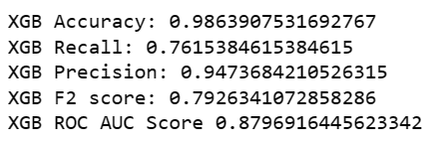
- **Accuracy:** 0.98
- overall correctness of the model's predictions is High.
- **Recall:** 0.76
- misses about 24% of actual fake job postings
- **Precision:** 0.94
- When the model predicts a job posting as fake, it is almost always correct.
- **F2 Score:** 0.79
- Good balance between recall and precision, with a higher emphasis on recall.
- Model relatively effective at correctly identifying fake job postings while maintaining a reasonable precision.
- **ROC AUC Score:** 0.88
- Above 0.5, indicating better-than-random performance, but there is still room for improvement.

